Slide 1
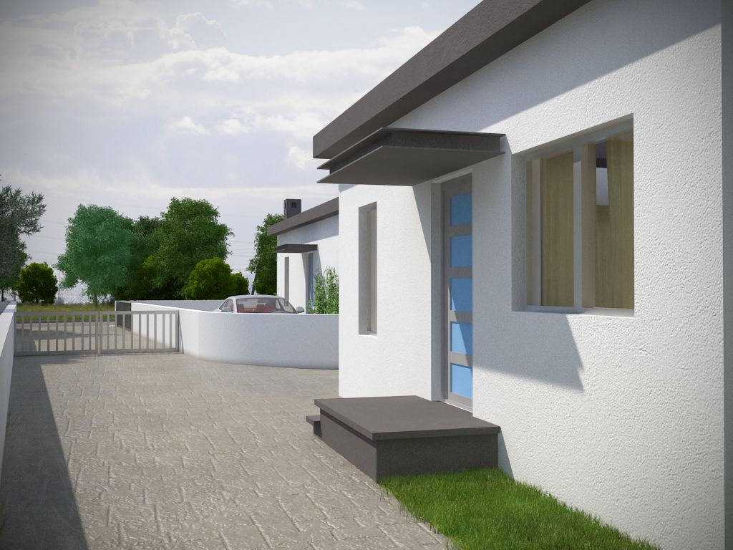
Moni, Limassol
For sale Detached house
General Information
Bedrooms | 3 | Baths | 2
Cov.area | 110m2 | Plot | 350m2
Parking | 2 | Heating | provision
Pool | No | Cooling | provision
Delivery | Delivered | Distance to sea | 3km

Slide 2
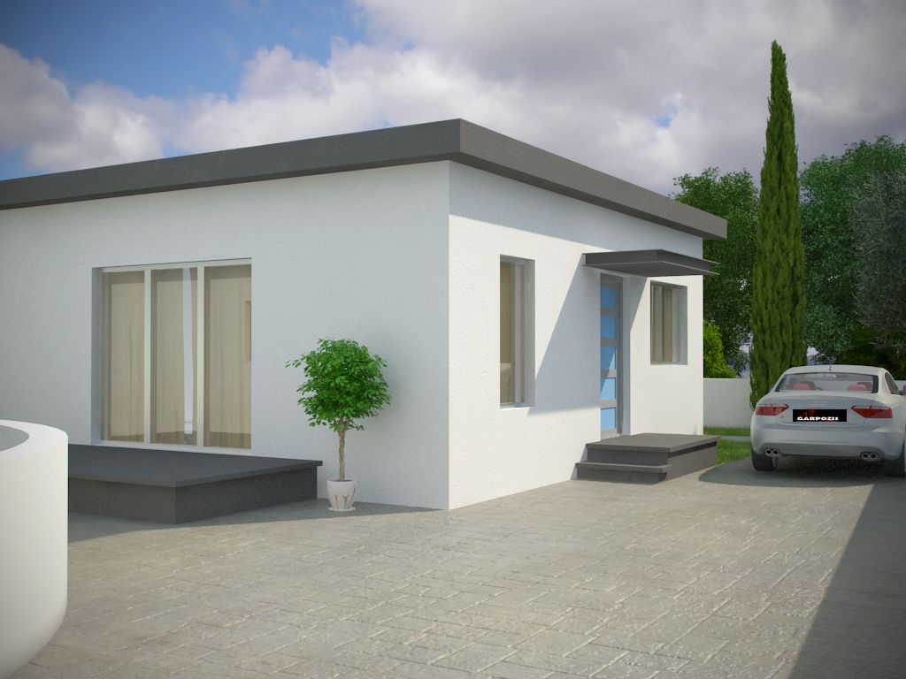
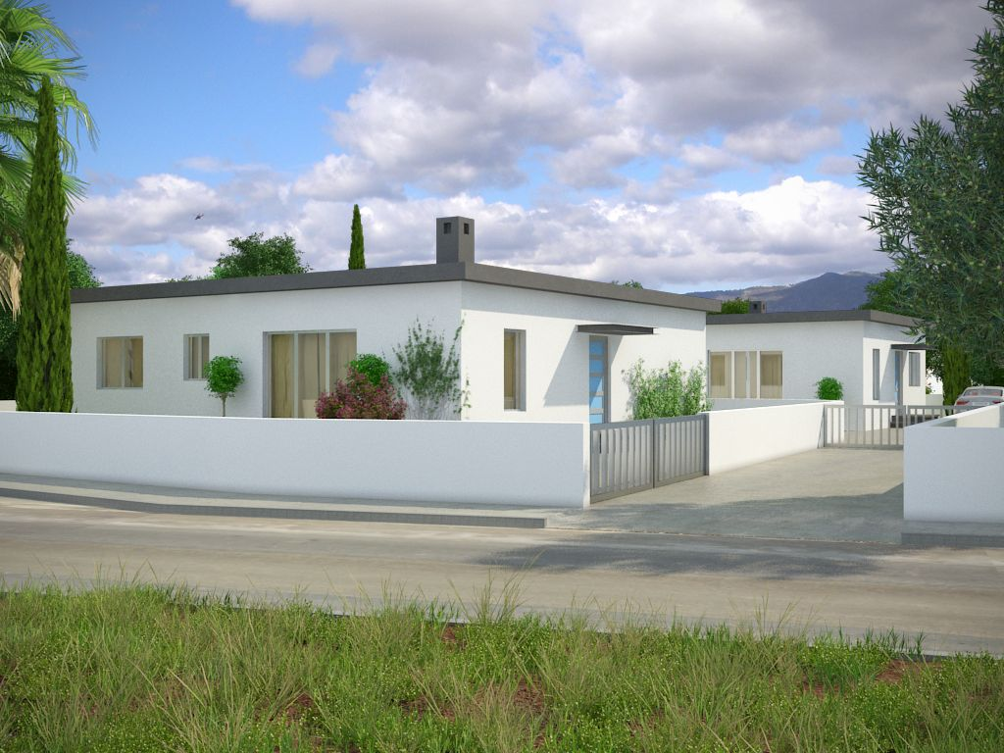

Slide 3
