Slide 1
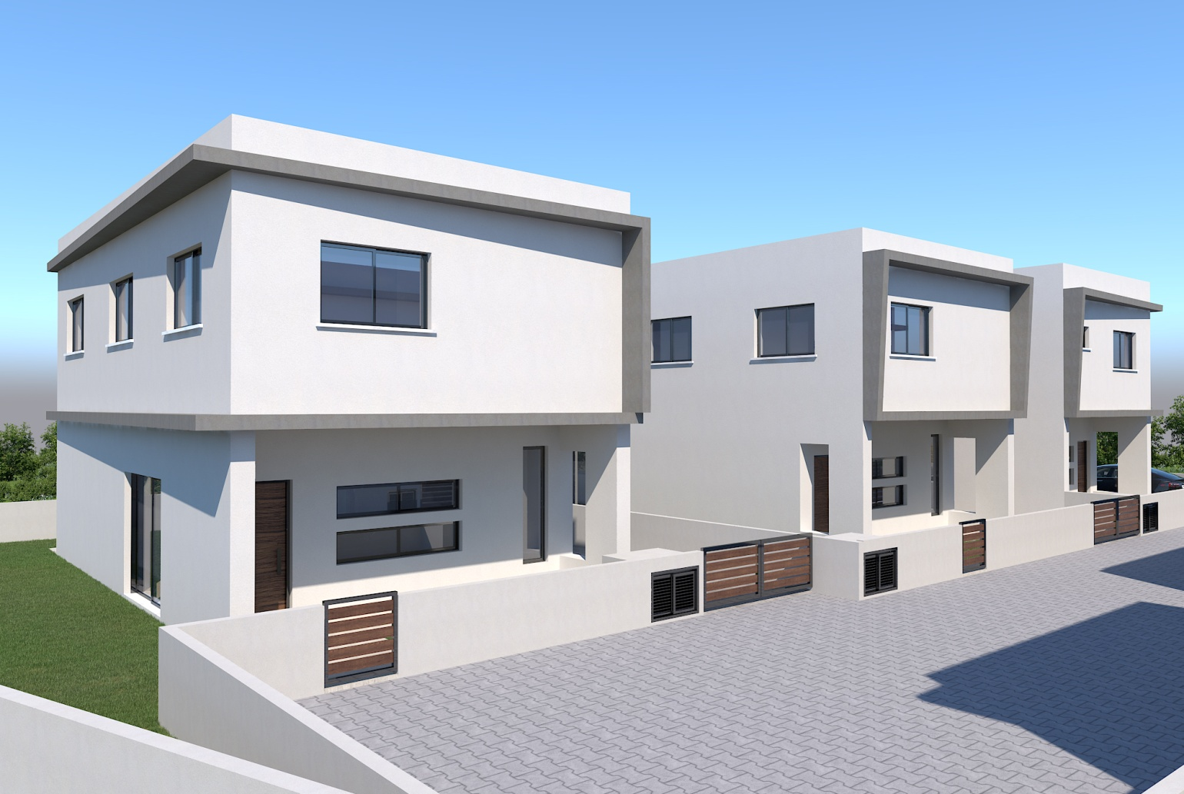
Detached House Fasoula
For sale Houses Fasoula Village €265.000+vat
General Information
Bedrooms | 3 | Bathrooms | 3
Covered area | 147.5 | Plot | 210sqm
Covered Parking | 1 | Heating | provision
Pool | no | Cooling | provision
Delivery | 2019 | Distance to city | 7km

Slide 2
Location

Slide 3
